Slide 1

A Deep Dive into Web Performance Testing: Playwright vs. Locust
Rodrigo Silva Ferreira
QA Engineer, POSIT PBC

Slide 2

About me
I’m from Salvador, Brazil, but live in Pittsburgh, PA.
Before tech, I did research in chemistry for 7 years.
I work as a QA Engineer at Posit PBC,
testing Positron, a next-generation data science IDE.
I’m excited to be in Colombia for the first time!

Slide 3
Welcome to my workshop! ¡Bienvenidos a mi taller!
Initial notes
We must follow the PyCon Colombia Code of Conduct:
https://2025.pycon.co/#/code-of-conduct
GitHub Repo with workshop materials: https://github.com/rodrigosf672/pyconcolombia2025
Connect with me: https://linkedin.com/in/rsf309

Slide 4
Let’s get started!
Intro to performance testing
Why should we care about performance?
Let’s tackle a problem together!
Concepts!
Intro to Playwright and Locust
Problem-based learning: specific questions we’re tackling!
An important warning!
Let’s work together!
Discussion about the results, limitations
Discussion around future directions: other websites, methods, ideas
Thank you for attending!

Slide 5
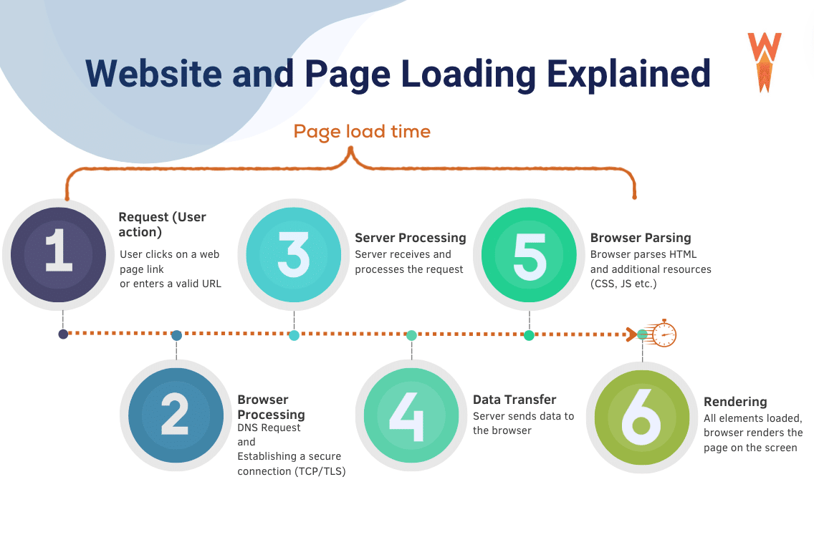
Intro to Performance
https://wp-rocket.me/blog/website-load-time-speed-statistics/

Slide 6
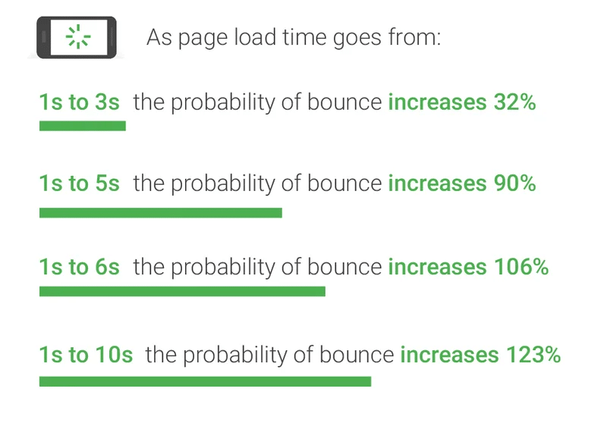
Why should we care about performance?
https://wp-rocket.me/blog/website-load-time-speed-statistics/

Slide 7

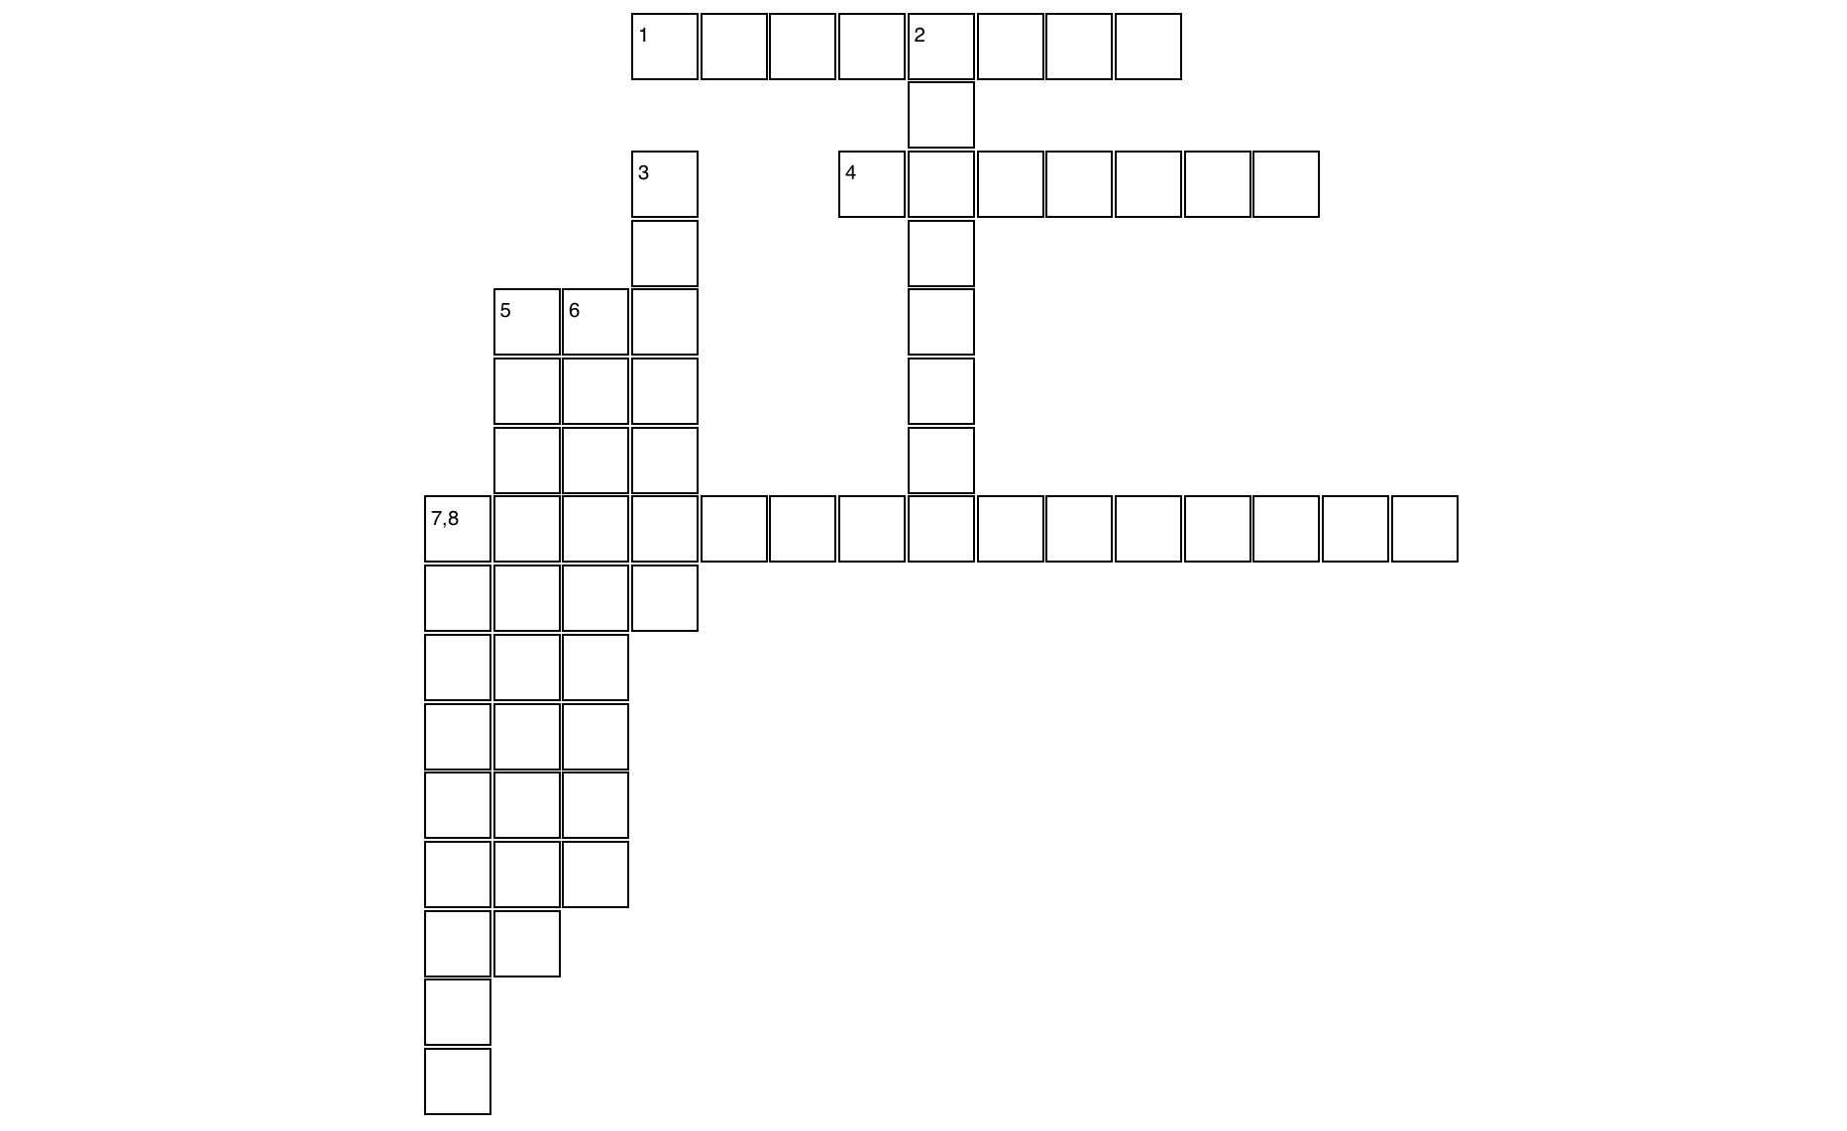
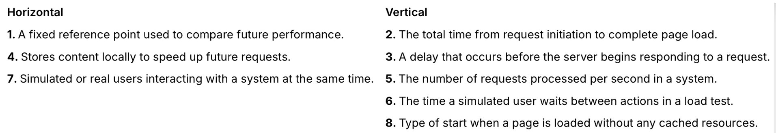
Built with Teachy
B A S E L I N E
O
D
T
I M
L
A
T
E
N
Y
C A C H I N G
T
H
R
U
GHP
U
T
T
H
I
K
T
I
M
E
BASELINE
CACHING
COLD START
CONCURRENT USERS
LATENCY
LOAD TIME
THINK TIME
THROUGHPUT
C O N C U R R E N T U S E R S
O
L
D
S
T
A
R
T

Slide 8


Let’s tackle a problem together!
How does navigation method affect website performance?
Does caching speed things up? Under which conditions?
What tools help us measure and simulate performance best?
Designed by Powerpoint Design Suggestions (Copilot)

Slide 9
Intro to Playwright and Locust
🎭 Playwright
Browser automation library
Simulates real user behavior (clicks, scrolls, typing)
Great for:
Page load time measurement
End-to-end testing
Scripted interactions
🐛 Locust
Load testing framework
Simulates thousands of users
Great for:
Measuring backend/server performance
Stress testing APIs
Real-time user behavior modeling
What tool(s) should we use for answering our questions?

Slide 10
Overview of questions
Question 1: Navigation Method
How does the method of navigation (clicking vs. direct links) impact loading times?
Question 2: Caching Effects
How does caching affect loading times, with each navigation method?
Question 3: Number of Books and Loading Times
Does the number of books in a category affect loading times?
Question 4: Load Testing
What happens to performance when we simulate many users at once?
Question 5: PyCon Website Load Times
How do PyCon websites from 2016–2025 perform in terms of load time?

Slide 11
⚠️ An important warning!
Before using automation tools like Playwright or Locust:
Always check the Terms and Conditions of the website. Automated access may violate the site's usage policy.
Avoid running substantial, load-heavy automated tests on any website you don't own or have explicit permission to test. Doing so can slow down or crash the site and may have legal consequences.
Respect robots.txt and site-specific limits: automation should behave like a responsible human user.
This workshop uses mainly www.books.toscrape.com, a practice site designed for testing and educational purposes.

Slide 12
Let’s work together!
Designed by Powerpoint Design Suggestions (Copilot)

Slide 13
Discussion
Results and Limitations
Future directions: other websites, methods and ideas
Overview of what we learned!
Designed by Powerpoint Design Suggestions (Copilot)

Slide 14

Thank you for attending!
Rodrigo Silva Ferreira QA Engineer at Posit PBC
LinkedIn: /rsf309
GitHub: /rodrigosf672
Email: rodrigosf672@gmail.com
https://twcmvla.com/build-a-better-world-campaign-together-we-can/

